Slide 1
Agile Manifesto
By PALash shah

Slide 2
What is Agile Manifesto?
The Agile Manifesto is a document that outlines the central values and principles of Agile software development
It was founded in Feb 2001 by 17 representatives from various programming backgrounds
It aims to provide an effective model for teams to successfully adopt the philosophy of Agile project management and use it to improve their work process.
It has 4 values and 12 principles

Slide 3
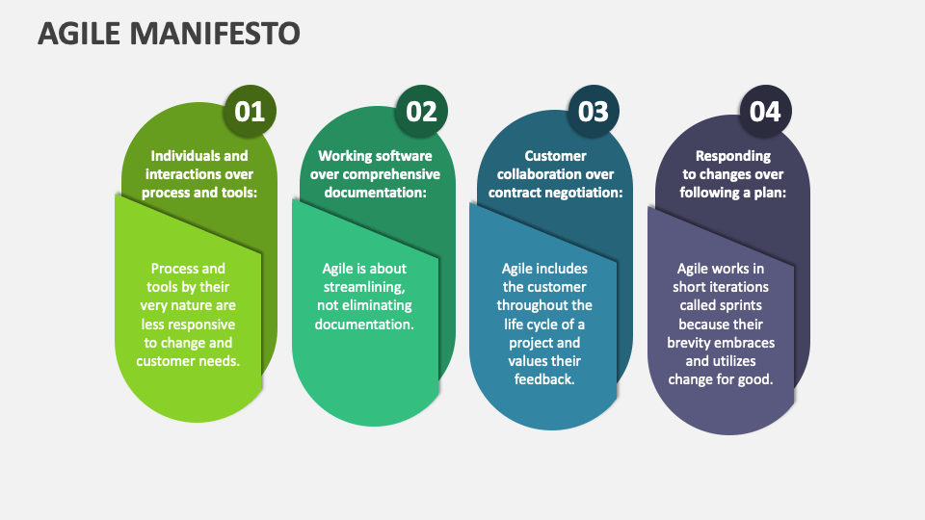
Values of Agile Manifesto

Slide 4
Values of Agile Manifesto
Individuals and Interactions over processes and tools
In the past, a lot of software teams would concentrate on having the best possible tools or processes with which to build their software
The Agile Manifesto suggests that while those things are important, the people behind the processes are even more so.
Having the right group of individuals on your software team is vital to success
The best possible tools in the wrong hands are worthless

Slide 5
Values of Agile Manifesto
Working software over comprehensive documentation
Previously, software developers would spend ages creating detailed documentation
While documentation isn’t a bad thing, there comes a point when you should focus on providing your customers with working software
The Agile Manifesto places shipping software to your customers as one of the highest priorities.

Slide 6
Values of Agile Manifesto
Customer collaboration over contract negotiation
In past, there might be a contrast between what the contract said, what the product did, and what the customer actually required.
According to the Agile Manifesto, the focus should be on continuous development
You need to build a feedback loop with your customers
The Agile Manifesto places shipping software to your customers as one of the highest priorities.

Slide 7
Values of Agile Manifesto
Responding to change over following a plan
In past, you would draw up a roadmap and it would never change.
But now the needs and requirements are always shifting, and priorities are always changing.
The Agile Manifesto suggests that a software team should have the ability to pivot and change direction whenever they need to
A dynamic roadmap can change from quarter to quarter, sometimes even month to month, and agile teams are able to keep up with those changes.

Slide 8
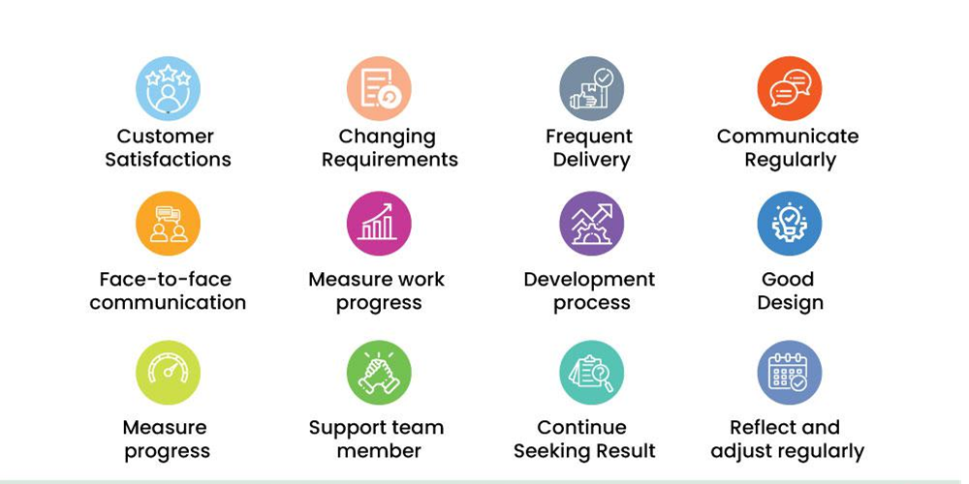
Principles of Agile Manifesto

Slide 9


Principles of Agile Manifesto
Our highest priority is to satisfy the customer through early and continuous delivery of valuable software
Welcome changing requirements, even late in development. Agile processes harness change for the customer’s competitive advantage
Deliver working software frequently, from a couple of weeks to a couple of months, with a preference to the shorter timescale
Business people and developers must work together daily throughout the project.

Slide 10

Principles of Agile Manifesto
Build projects around motivated individuals. Give them the environment and support they need, and trust them to get the job done.
The most efficient and effective method of conveying information to and within a development team is face-to-face conversation
Working software is the primary measure of progress
Agile processes promote sustainable development. The sponsors, developers, and users should be able to maintain a constant pace indefinitely

Slide 11
Principles of Agile Manifesto
Continuous attention to technical excellence and good design enhances agility.
Simplicity — the art of maximizing the amount of work not done — is essential
The best architectures, requirements, and designs emerge from self-organizing teams.
At regular intervals, the team reflects on how to become more effective, then tunes and adjusts its behavior accordingly.

